Slide 1
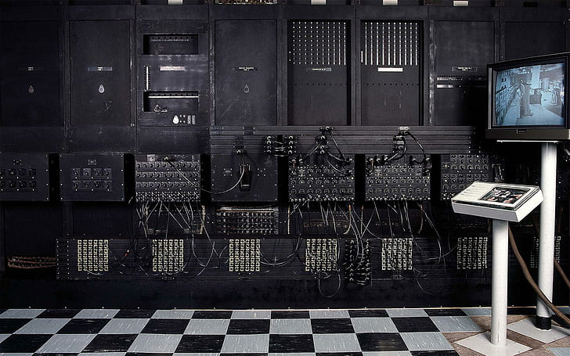
STIGE
Virtual Internship
Virtual Presentation
History Of Computers
Presented by
Shubham Agarwal

Slide 2
About Computer
Computer is a machine which can perform many tasks
A computer is an electronic device that manipulates information, or data. It has the ability to store, retrieve, and process data
It was originally invented to do speedy and accurately calculations , and also it can be used for other purposes too.

Slide 3
History
In early as Seventeenth century many of mathematicians were trying to create a machine that could perform basic mathematical functions such as Addition Subtraction Multiplication or Divide.

Slide 4
The Computer era
Dark
Modern
All computing devices of dark age are mechanical devices.
In this age the computer technology and Ideology are improved.
It categorized in five generations.
Middle
These devices are powered by stem.
They had storage capacity

Slide 5
01
ABACUS
Invented in – China.
Early merchants used the ABACUS to keep trading calculations.
NAPIER BONES
02
Invented by – John Napier.
This device consisted on eleven bones or rod with numbers.
SLIDE RULE
03
Created by – William Outhered.
This RULE is based on NAPIER’s logarithms.
PASCAL’s CALCULATOR
Dark Age
04
Invented By – Blaise pascal.
Consisted on a brass rectangular, used eight movable dials to add number up to eight figures long.
Devices used in this age

Slide 6
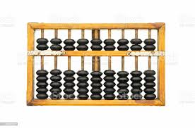
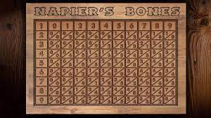
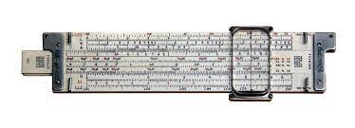
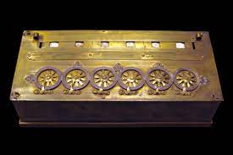
Dark Age

Slide 7
01
Babbage’s Difference Engine
Invented by – Charles Babbage (Father of Computer).
He proposed a machine to perform differential equation, called a Difference Engine.
Hollerith’s Tabulating Machine
02
Invented by - Herman Hollerith.
the machine was developed to help process data for the 1890 U.S. Census
Medium Age
Devices used in this age

Slide 8
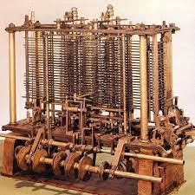
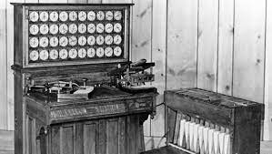
Medium Age

Slide 9
01
First Generation (1939-1957)
Vacuum Tube
Second Generation (1957-1959)
02
Transistor
Third Generation (1959-1971)
03
Integrated Circuit
04
Fourth Generation (1971-1990)
Microprocessor
Modern Age
05
Fifth Generation (Present and beyod)
Generation in this age
Artificial Intelligence

Slide 10

STIGE
Virtual Internship
Virtual Presentation
THANK YOU!
Email id- shubhamagarwal7219@gmail.com

